Slide 1
Stacks In Java
Anthony Clark
Frederick Cashaw
Robert J. Sutton
Randall Hale
Khalid Ettaleb
William Bjerke
Screenshots and information from GeeksforGeeks and oracle

Slide 2
What is a Stack?
A linear data structure using a LIFO(last in, first out), or FILO(first in, last out) model
Usually implemented with an array due to the lack of needing to delete an object in the middle of it.
Basic methods:
The push() method puts an element on top
The pop() method returns the top element and deletes it from the stack
The peek() method returns the top element

Slide 3
What is a Stack?
Last in first out means that objects put in a stack are taken out in reverse order.
Good examples are a Pringels can, stack of plates, or a deck of cards.
Elements should not be taken or added out of order.
Used in code like an undo feature, website forward and backward button, or backtracking in a video game

Slide 4
Stacks in Java
There are two main ways to create stacks in Java
Class Stack
Use a class that implements the interface Deque, such as
Class ArrayDeque
Class LinkedList

Slide 5
Stack Class
The legacy way to make stacks in Java. It is recommended you use the Deque interface and it’s implementations
However, it is easier to use correctly
Implements from Vector, which is an array which can change size

Slide 6
Stack Class
java.util
Class Stack<E>
java.lang.Object
java.util.AbstractCollection<E>
java.util.AbstractList<E>
java.util.Vector<E>
java.util.Stack<E>
All Implemented Interfaces:
Serializable, Cloneable, Iterable<E>, Collection<E>, List<E>, RandomAccess

Slide 7
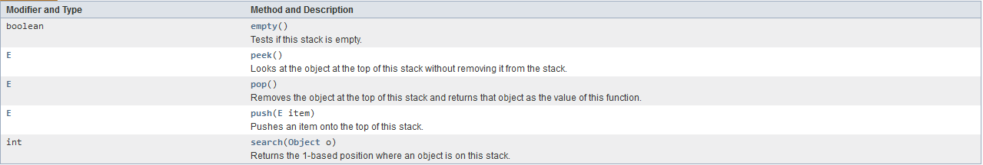
Stack Class
Fields:
capacityIncrement, elementCount, elementData
Constructor:
Stack()
Creates an empty Stack.
Methods:

Slide 8
Deque Interface
A deque is a double ended queue. By using some of the methods, a deque can be used as a stack
Implemented by ArrayDeque, ConcurrentLinkedDeque, LinkedBlockingDeque, LinkedList
You can also implement it in your own program to create your own stack, queue, or dequeue
Using the deque interface is preferable to using the Stack Class.
You can use this to have your stack be an array or linked list

Slide 9
Deque Interface
java.util
Interface Deque<E>
Type Parameters:
E - the type of elements held in this collection
All Superinterfaces:
Collection<E>, Iterable<E>, Queue<E>
All Known Subinterfaces:
BlockingDeque<E>
All Known Implementing Classes:
ArrayDeque, ConcurrentLinkedDeque, LinkedBlockingDeque, LinkedList

Slide 10
Deque Interface
Dequeue Interface and classes that implement it do not have push, pop, and peek. Instead use the equivalent method.

Slide 11
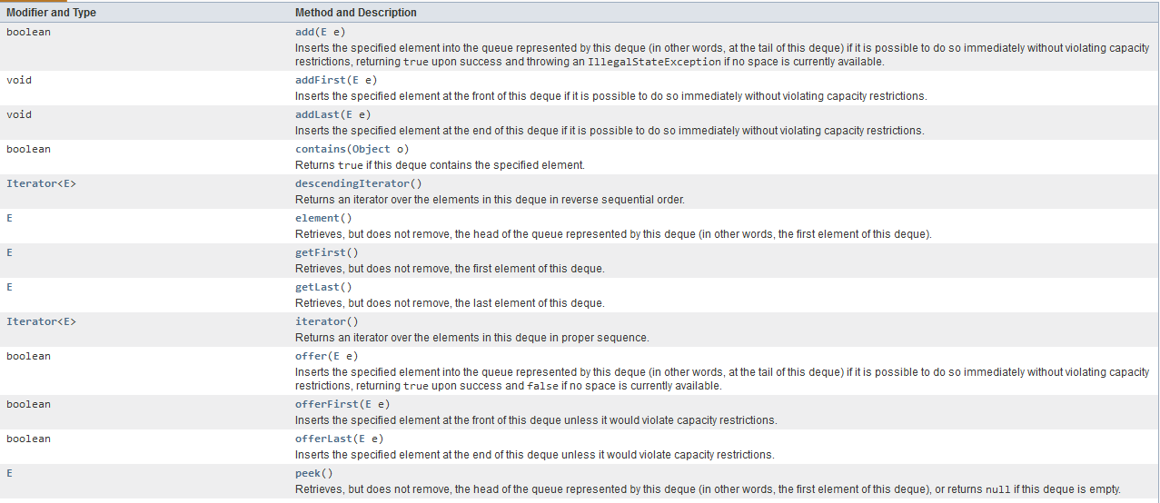
Deque Interface Methods

Slide 12
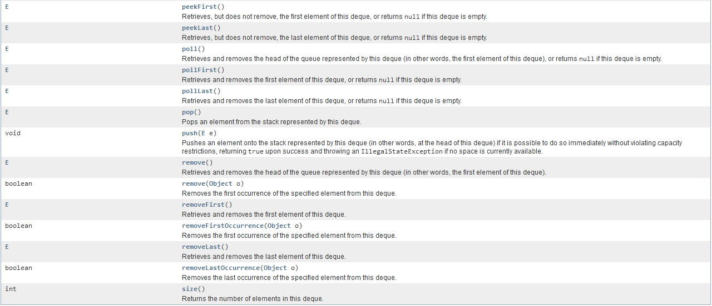
Deque Interface Methods

Slide 13
Summary
Stacks are a way to store data in a specific way that is useful to programmers.
They store data in a linear structure. Either as an array or a linked list
Arrays are more data efficient, linked lists can take up a non-continuous space of memory and are dynamically sized
Basic methods:
The push() method puts an element on top
The pop() method returns the top element and deletes it from the stack
The peek() method returns the top element

